Slide 1
Customer Segmentation Using RFM Analysis
By:- Tabish Shamim

Slide 2
Problem Statement and Objective
Problem Statement:
E-commerce businesses generate vast amounts of transactional data but often struggle to leverage it for actionable customer segmentation. Understanding purchasing patterns is crucial for predicting behavior, improving retention, reducing churn, and maximizing customer lifetime value. A structured approach is needed to identify high-value customers, detect trends, and optimize targeted marketing strategies.
Objective:
Utilize the RFM (Recency, Frequency, Monetary) framework to segment e-commerce customers.
Analyze purchasing patterns to identify high-value customers and at-risk segments.
Create targeted marketing strategies to improve customer retention and satisfaction.

Slide 3
Dataset Overview
Source: [Kaggle – E-Commerce Dataset]
Size: (541909, 8)
Timeframe: 01/12/2010 – 09/12/2011
Key Variables:
Invoice No: Unique transaction ID
StockCode: Unique Product Identifier
Description: Product Description
Quantity: number of items purchased
InvoiceDate: Timestamp of purchase
Unit Price: Price per unit in GBP
Customer ID: Unique Customer Identifier
Country: Location of the customer

Slide 4
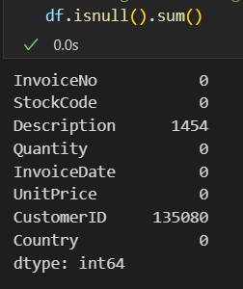
Data Cleaning and Preparation
Handling Missing Values
Removed Duplicates
Removed Cancelled Orders
Removing Non-Product StockCodes
24.93% of the values in the CustomerID column are missing
The missing CustomerID values were deleted because the study focuses on examining customers and grouping them into segments.

Slide 5
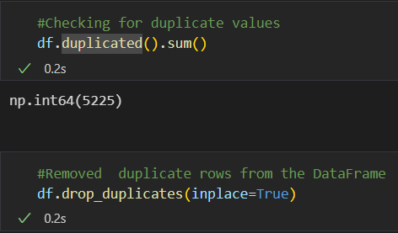
Data Cleaning and Preparation
Handling Missing Values
Removed Duplicates
Removed Cancelled Orders
Removing Non-Product StockCodes
A total of 5225 duplicated rows were there in the dataset which were removed.

Slide 6
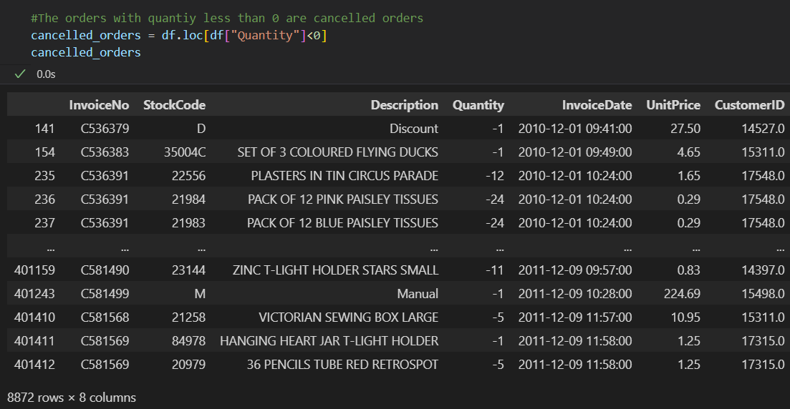
Data Cleaning and Preparation
Handling Missing Values
Removed Duplicates
Removed Cancelled Orders
Removing Non-Product StockCodes
The dataset contains 8,872 entries with negative quantities, which could result from data-entry mistakes, returned orders, or cancellations. Upon inspection, all such invoices start with the letter 'C,' confirming they are cancelled transactions. Consequently, these records were excluded from the analysis.

Slide 7
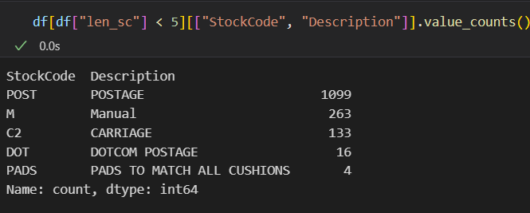
Data Cleaning and Preparation
Handling Missing Values
Removed Duplicates
Removed Cancelled Orders
Removing Non-Product StockCodes
The dataset contained StockCodes that were not linked to any actual products. These entries were filtered out and deleted.

Slide 8
The data reveals that 26% of the customer base drives 80% of the company's income, following a Pareto-like distribution.

Slide 9
The revenue distribution follows the 80/20 pattern, with 21% of products accounting for 80% of sales.

Slide 10
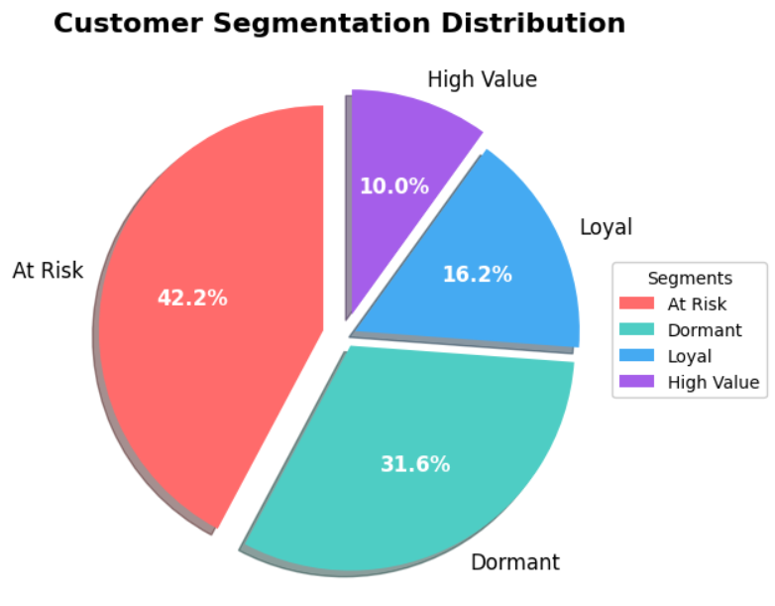
RFM Analysis and Customer Segmentation
What is RFM?
RFM (Recency, Frequency, Monetary) is a customer segmentation method that analyzes:
Recency: How recently a customer purchased
Frequency: How often they buy
Monetary: How much they spend
RFM Segmentation Process:
Scoring: Each customer is scored (typically 1-5) for Recency (most recent purchase), Frequency (total transactions), and Monetary (total spend).
Grouping: Scores are combined (e.g., R+F+M) or analyzed separately to create segments (e.g., "High-Value" = 555, "At-Risk" = 155).
Action: Segments guide targeted strategies—like loyalty rewards for "Champions" (555) or win-back campaigns for "Lost" customers (111).

Slide 11
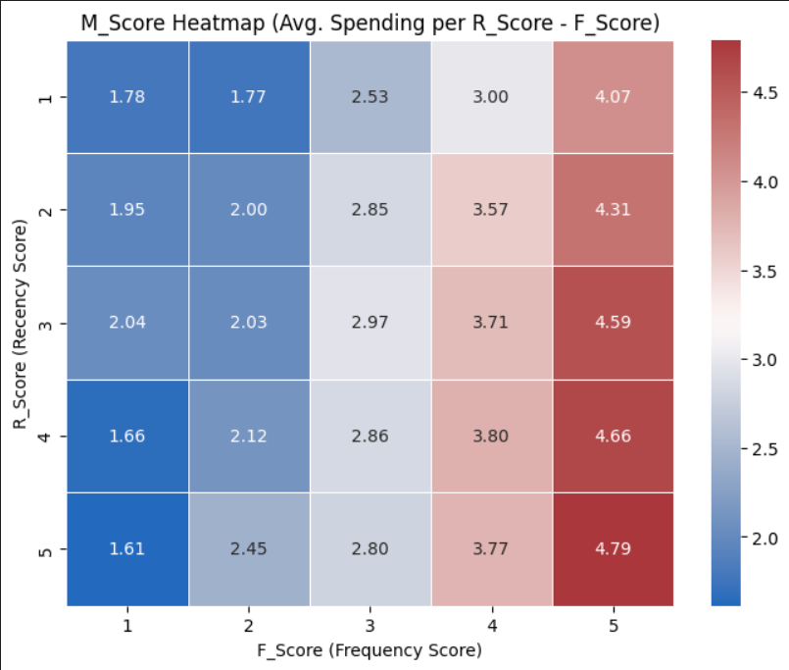
Heat map based on RFM score

Slide 12
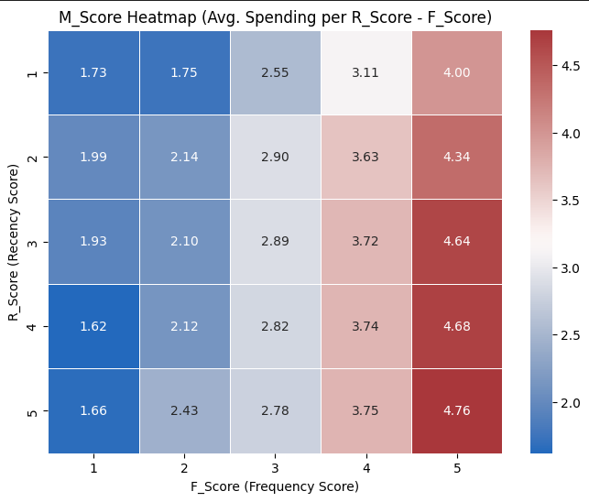
RFM Analysis and Customer Segmentation
The customer base has been segmented into four groups based on RFM scoring:
High Value (top performers)
Loyal (regular buyers)
At-Risk (declining engagement)
Dormant (inactive) customers

Slide 13
Recommendations based on customer segments
High Value Customers
Characteristics: These are recent, frequent and high spenders.
Behavior: Top spenders who buy often and recently.
Strategy: Reward with exclusives (VIP perks, early access) to retain loyalty.

Slide 14
Recommendations based on customer segments
Loyal Customers
Characteristics: These are frequent but moderate spenders.
Behavior: Regular buyers with strong brand affinity but lower spend than High-Value.
Strategy: Strengthen retention (loyalty points, personalized recommendations).

Slide 15
Recommendations based on customer segments
At-Risk Customers
Characteristics: These were previously frequent but declining activity.
Behavior: Showing signs of churn (less frequent purchases).
Strategy: Win-back campaigns (discounts, "We miss you" emails, feedback requests).

Slide 16
Recommendations based on customer segments
Dormant Customers
Characteristics: These customers have no recent purchases.
Behavior: Long-time inactivity, may have switched brands.
Strategy: Reactivate with incentives (time-sensitive offers, re-engagement surveys).

Slide 17
Thanks! Contact: Tabish Shamim +91 7800090800 tabishshamim94@gmail.com

